Slide 1
PHP/MySQL 5
Database Programming - Report

Slide 2
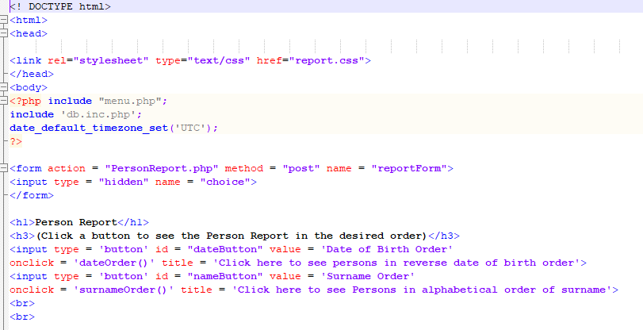
PersonReport.php
Try It!

Slide 3
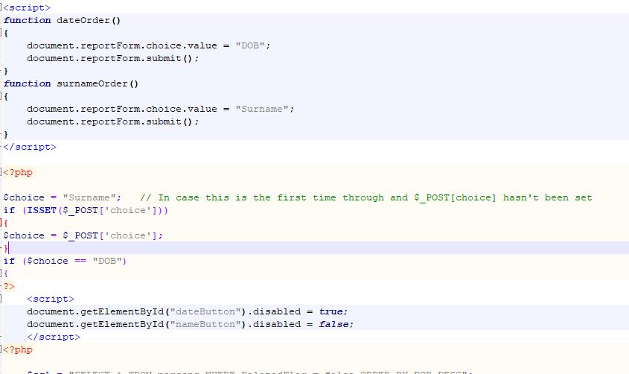
PersonReport.php (contd.)

Slide 4
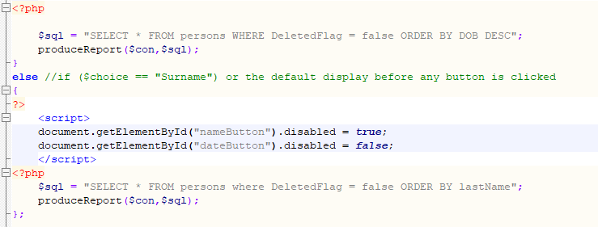
PersonReport.php (contd.)

Slide 5
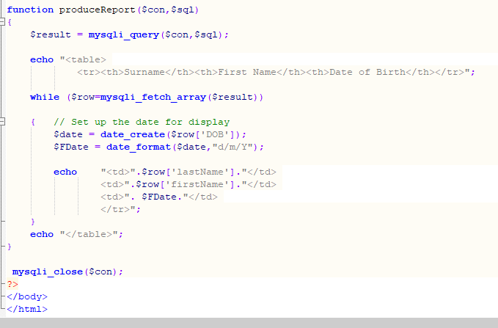
PersonReport.php (contd.)

